Slide 1
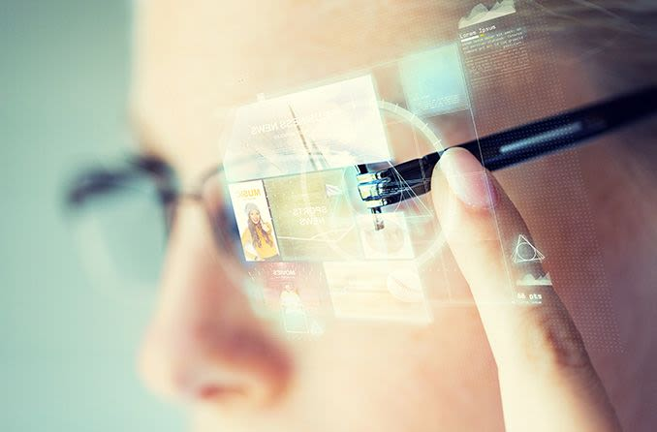
Smart glasses
Julien Druelle, Mathieu Vidot and Jonathan Morgado

Slide 2
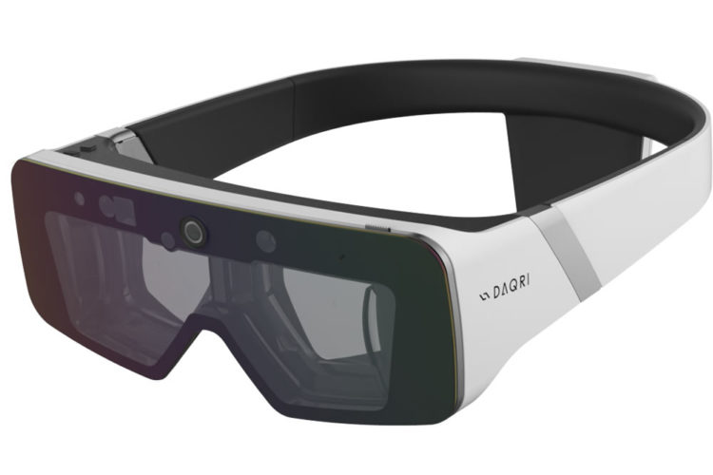

Slide 3
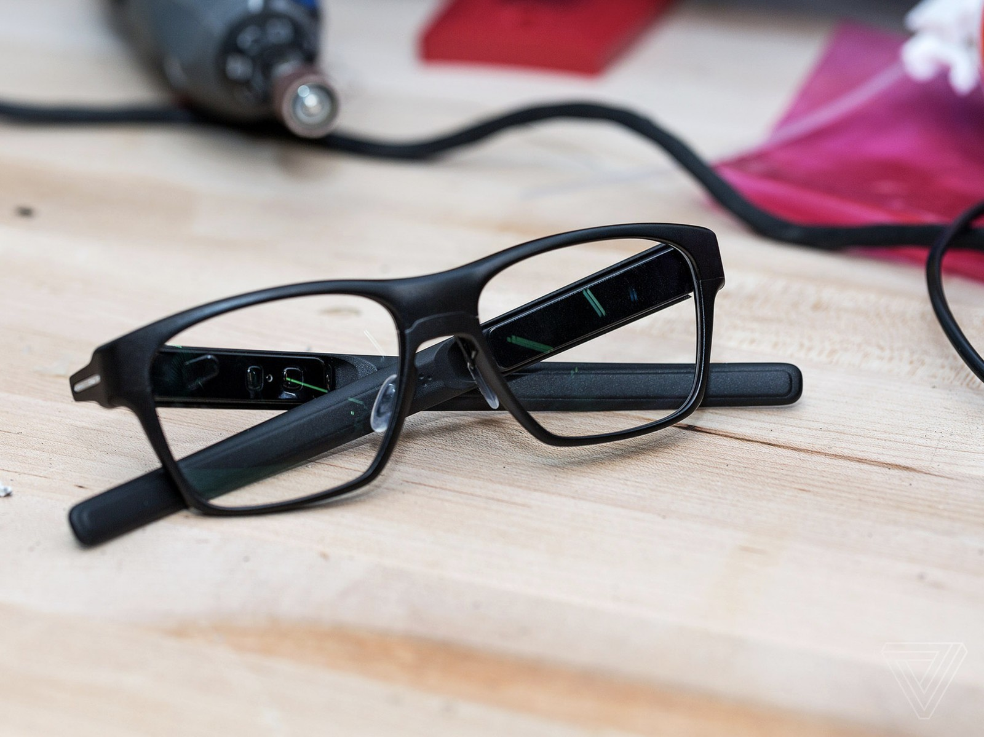
Our Glasses

Slide 4
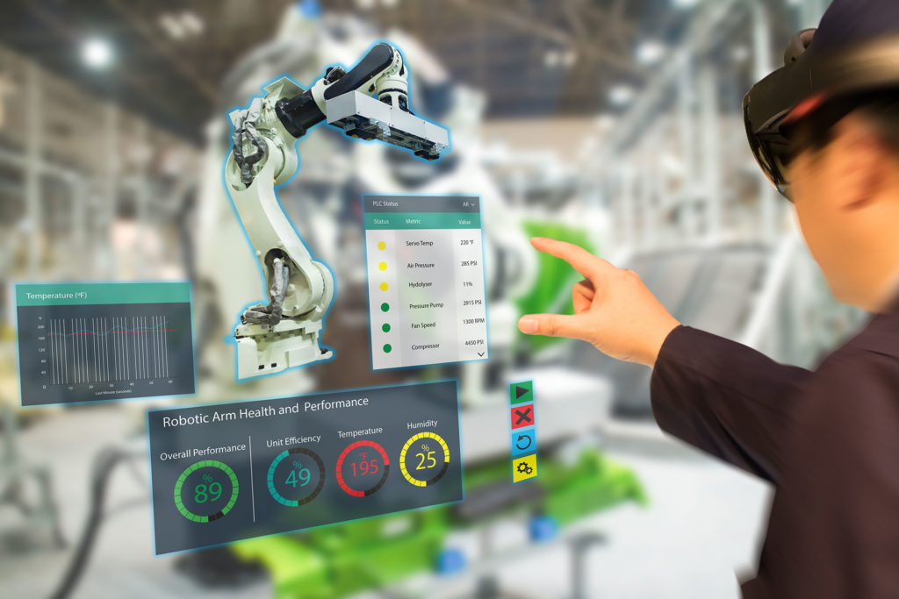








+1,000 apps
2 TB
-30 minutes !
+8 hours !

Slide 5
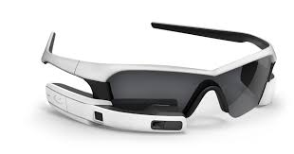
Sport edition

Slide 6
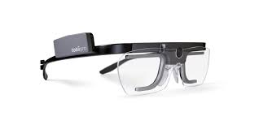
Professional edition

Slide 7
Conclusion

